Slide 1

Municipal Solid Waste Management Strategy for Class – II Cities in India
ES315: Solid waste Management
Supervisor: Prof. Anurag Garg
Submitted By:
Naman Agarwal: 19D180017 Pranav Mahadkar: 19D180019

Slide 2
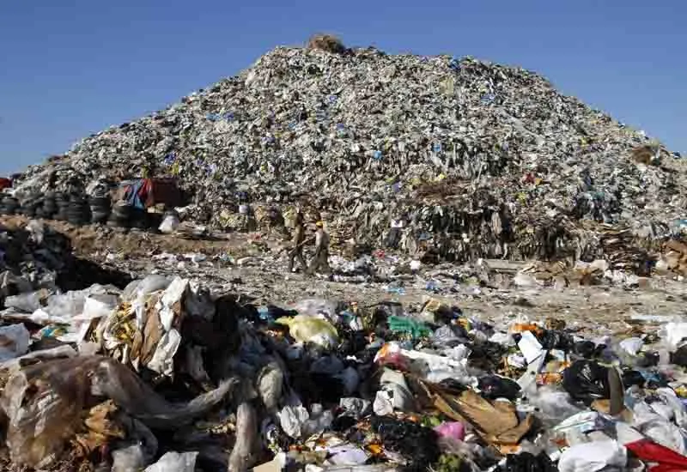
What is Municipal Solid Waste?
MSW ordinarily known as junk or trash in the United States and as reject or refuse in Britain, is a waste sort comprising of regular things that are disposed of by people in general. "Trash" can likewise allude explicitly to food squander, as in a waste disposal; the two are now and again gathered independently.
Municipal solid waste includes waste including commercial and residential wastes generated in a municipal or notified areas in either solid or semi solid form excluding industrial hazardous wastes but including treated biomedical wastes

Slide 3
Nature of the problem
The amount of waste created all around the world added up to in excess of 13 billion tons in 2011, with appraisals of as much as 18 billion tons in 2020.
The quick expansion in populace combined with changing way of life and utilization designs is relied upon to bring about a remarkable expansion in squander age of up to 23 billion tons by the year 2030.
Agricultural Nations and Countries with better quality of living produce more waste Need for inventive and ecological well-disposed drives for creating Power
Conventional Methods (unloading and consuming) are presently not acknowledged
Metropolitan regions running out of spots to put trash

Slide 4
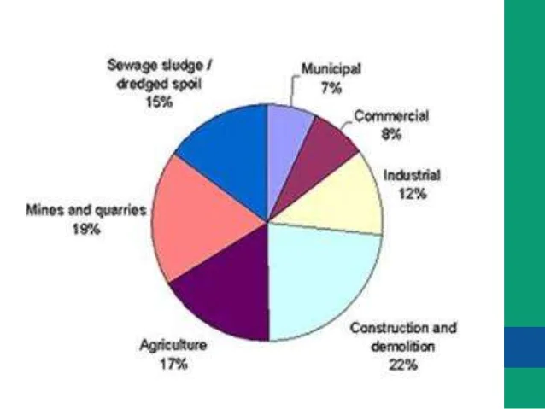
MSW in India
India is the second-biggest country on the planet, with a populace of 1.21 billion, representing almost 18% of the world's human populace.
The yearly waste age has been seen to increment with respect to the ascent in populace and urbanization, and issues identified with removal have become tried as more land is needed for a definitive removal.
The extent of the populace dwelling in metropolitan regions has expanded from 27.8% in 2001, 31.8% in 2011, and prone to reach half by 2030.
India is confronting a sharp differentiation between the expanding metropolitan populace and accessible administrations and assets. strong waste administration is one such help where India has a tremendous hole to fill.

Slide 5
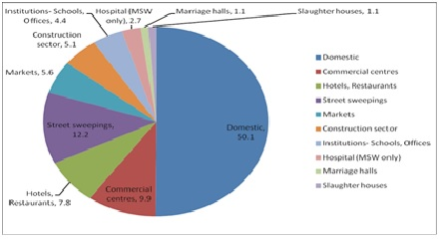
MSW Generation in India
It is assessed that Urban India creates about
2 lakhs tons each day.
The per capita squander age rate in India has expanded from 0.44kg/day to 0.5kg/day in 2011 and 0.6kg/day in 2020
The waste age rate in Indian urban areas ranges btw 200-870 grams/day, contingent on the locale's way of life and the size of the city. The per capita squander age is expanding by around 3% each year in India
India at present is the world's fifth-greatest energy purchaser and is anticipated to outperform japan and Russia to take the third spot by 2030

Slide 6
MSW Scenario Of Class-II Cities
The quality and measure of MSW produced by a specific city moves according to their financial status, populace and business exercises, and so on.
Arranging, activity, and planning of MSWM should be possible based on synthesis and the amount of MSW created. Class-II urban communities squander contains more natural material and less perilous material.
Class-II urban communities create on a normal 3991 MT/day of MSW. Numerous experts say that the MSW age rates in humble communities are lower than those of metro urban areas, and the per capita age pace of MSW in India goes from 0.2 to 0.5 kg/day.
The synthesis of MSW from medium and limited scope towns contains biodegradable waste (50 – 65 %) and non-biodegradable waste (35 – 50 %). This shows that there is higher biodegradable waste in class-II urban communities.
MSW of these towns contains around 11% paper and cardboard, 40% natural waste, 34% non-biodegradable, and 14% plastic waste in Gujarat state.
Most class-II towns don't have explicit methods of assortment, transportation, and removal. A portion of these towns is making depots for halfway isolation of the strong waste.

Slide 7
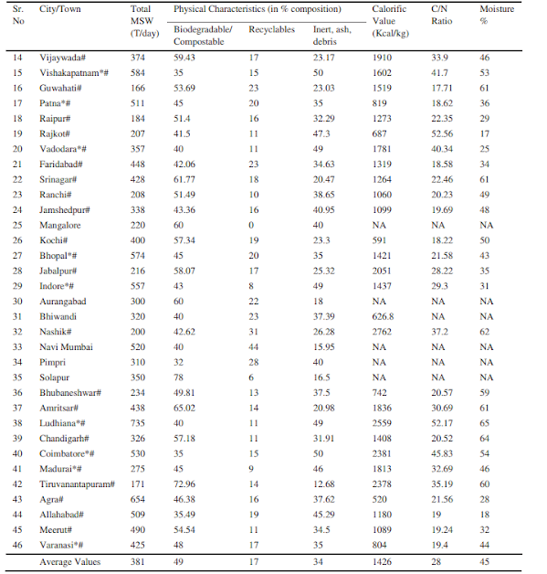
Quantity of MSW generated from Tier 2 cities
The trash is by and large unloaded and consumed straightforwardly. Waste administration is given low need and spending plan, which settles on the dynamic cycle slow. It has become more troublesome because of an absence of attention to the rules; natural worries with lacking assets have caused a tumultuous circumstance. It is alluring to advance an appropriate technique to manage MSWM of class-II towns.

Slide 8
Strategy and Framework for SWM
The executives of waste might be characterized as the control of age, stockpiling, assortment, move and transport, handling, and removal of strong squanders dependent on logical standards.
There are various ideas about squandering the executives that differ in their use between nations or areas. Probably the broadest and generally utilized ideas include:
Waste Hierarchy
Polluter pays principle
Extended producer responsibility

Slide 9
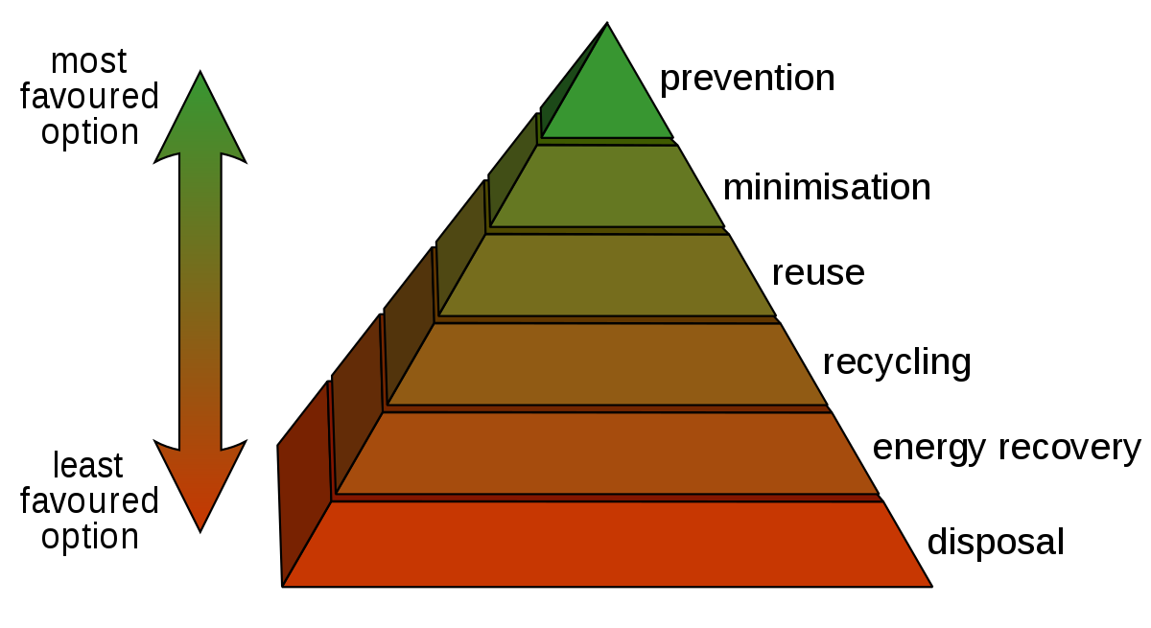
Waste Hierarchy: The waste chain of command alludes to the "4 Rs" idea (diminish, reuse, reuse and recuperate), which group squander the board systems as indicated by their attractiveness as far as waste minimization. It stays the cornerstone of most waste minimization procedures. The fundamental point is to extricate the greatest reasonable advantages from items and to create the base measure of waste.
Polluter pays principle - It is a standard where the contaminating party pays for the effect caused to the climate. Here, it alludes to the prerequisite for a waste generator to pay for the fitting removal of the waste.
Extended producer responsibility – EPR is a technique intended to advance the mix of all expenses related to items for the duration of their life cycle into the market cost of the item. It is intended to force responsible for the whole lifecycle of items and bundling acquainted with the market. This implies that organizations that assembling, import, and additionally sell items are needed to be liable for the items after their helpful life just as during produce.

Slide 10
General Approach and Strategy
It ought to be more centered around decentralized waste administration however much as could be expected
The biodegradable squanders can be gathered and handled locally at the actual source
Evaluating waste age as indicated by the season is a significant precondition for framework arranging
Specialists need to consider specific systems for various waste generators and proper measures for the various levels in the SWM chain
Decentralized waste administration will assist with decreasing the transportation of squanders, lessen the quantum of squanders arriving at the unified plant, and diminish the land necessities and different issues identified with the treatment of huge amounts in a solitary area.

Slide 11
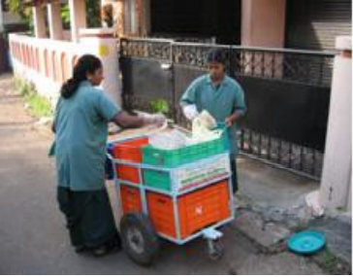
Activity wise Strategy & Framework
Step 1: Improve Waste Segregation and Storage at Source
The main strategy is to separate the biodegradable wastes and non biodegradable wastes at the source itself and store the waste in different coloured bins
Step 2: Primary Collection
The strategy for primary collection is the gathering of separately stored biodegradable and non-biodegradable waste from door to door/ kerb / block of waste and direct collection from non- domestic bulk generators

Slide 12
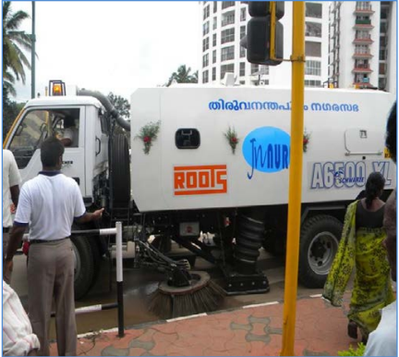
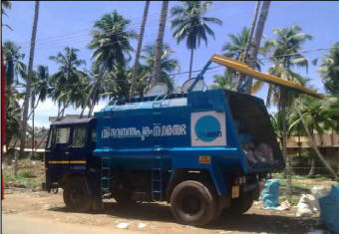
Step 3: Street Sweeping
The strategy for primary collection is the gathering of separately stored biodegradable and non-biodegradable waste from door to door/ block of waste and direct collection from non- domestic bulk generators
Step 4: Set Up Secondary Waste Storage Depots and Transfer Stations
Collection and transportation of waste from secondary collection points to the disposal site is termed as secondary collection system.The strategy for secondary collection is abolition of all open collection points by placing containers, i.e., separate containers for organic and inorganic waste
Step 5: Improve Transport of Waste
This step refers to the transport of large quantities of waste to treatment sites or the final disposal site. Under the 2000 rules, a covered vehicle should be used for transportation of waste. Therefore, the present uncovered vehicles will need to provide a cover and in the future suitable covered vehicle should be used.

Slide 13
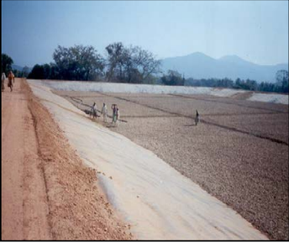
Step 6: Establish Treatment and Recycling Options
The sixth step was made mandatory under the 2000 rules. Municipal authorities are expected to set up a plant for composting waste or to adopt waste to energy technology as may be appropriate to treat the organic fraction of wastes
Step 7: Final Disposal by Constructing Sanitary Engineered Landfills
The 2000 rules prohibit open dumps and require municipal authorities to safely dispose of solid waste in engineered landfills. The rules further mandate treatment of the organic fraction of solid wastes before final disposal in the landfill sites. Thus, only rejects and degraded wastes can be placed in landfills.

Slide 14
MSW DISPOSAL & TREATMENT
The two driving creative instruments of garbage removal being embraced in India incorporate treating the soil (oxygen consuming fertilizing the soil and vermicomposting) and squander to-energy (WTE) (burning, pelletization, bio methanation). WTE projects for the removal of MSW are a generally new idea in India. Albeit these have been attempted and tried in created nations with positive outcomes, these are yet to make headway in India to a great extent on account of the way that monetary reasonability and maintainability are as yet being tried. Various techniques for the removal furthermore, treatment of MSW have been examined in the ensuing segments.

Slide 15
MSW to energy technologies
Biomethanation / Anaerobic Digestion:In bio methanation, the natural biodegradable portion is deteriorated (enzymatically) by microbial activity also, this strategy is exceptionally helpful for squanders containing a high level of natural biodegradable matter (>35%) and a significant degree of dampness (>45%) alongside a C/N proportion of 20-30%. The force created from
MSW by bio methanation strategy can be dictated by utilizing a numerical relationship.
Terminologies:
X = Biogas produced (m3 per kg of volatile solids per day)
Y = Digester efficiency (%)
Z = Total organic fraction (%)
L = Organic biodegradable fraction (%)
W1 = Total Waste generated everyday (tones)
h = Conversion efficiency (%)
W2 = is a constant = (860 x 24)^(-1)
CV = Calorific Value of MSW (kcal/m3 )
Let: P = X * Y * Z * L * W1 * 1000
& Q=W2 * CV * h
Now, Net power generation(kw)=P*Q
By and large, 100 tons of crude MSW with 40-60% natural matter can create around 0.534-1.71 MW power contingent upon the waste qualities.

Slide 16
Anaerobic Composting
In this strategy, the waste is presented to anaerobic organisms, similar to microorganisms, what breakdown the natural matter without oxygen. The energy is recuperated in the structure of biogas and manure as a fluid lingering. Biogas comprises of methane and carbon dioxide and can be utilized as fuel or, by utilizing a generator it tends to be changed over to power nearby. The fluid slurry can be utilized as natural manure. Biogas is an exceptionally effective fuel. This measure is additionally named as Biomethanation.

Slide 17
Refuse Derived Fuel
RDF alludes to the isolated high calorific part of prepared MSW. RDF can be characterized as the eventual outcome from squander materials which have been handled to satisfy rule, administrative or industry particulars essentially to accomplish a high calorific worth to be helpful as optional/substitute energizes in the strong fuel industry. The main property of RDF is that, in contrast to coal, it tends to be inferred and fabricated and thus is inexhaustible. RDF is primarily utilized as a substitute to coal (a petroleum product) in high-energy mechanical measures like force creation, concrete furnaces, and steel fabricating.

Slide 18
Operational Modalities
Roles and responsibilities of ULBs
Procurement of equipments and implements for collection of wastes vehicles for transportation of wastes, establishment of waste processing and treatment facilities as per MSW Rules,2000.
Planning and Implementation of street cleaning, bulk waste collection programmes etc.
Identification of suitable sites for waste processing and disposal, identification of sites for future.
Discourage use of undesirable plastic materials, encourage to reduce waste, reuse materials etc.
Planning for sale of products like compost, MoU with sector departments and fertilizer firms for sale of manure produced; marketing of manure through Local Residents Associations, SHGs, NGOs etc

Slide 19
Role of NGOs/Residents’ Associations
NGOs and Residents‟ Associations can play a vital role in SWM. Some areas where they can effectively work are indicated below:
Organizing neighbourhood groups (NHGs) and imparting motivational training for storage and segregation of waste
Organizing waste collection groups
Propagating the 4R concept and the proximity theory
Organizing, training and equipping the rag pickers as doorstep waste collectors.
Generating demand for household level waste management options like vermi composting and providing skilled services in setting up household units
Man Power Requirement
Collection workers and auto three wheeler drivers for door to door collection- to be mobilized by Kudumbashree /NGOs/RAs etc Workers and drivers for street sweeping, direct collection and transportation- to be mobilized by ULB / Kudumbashree /NGOs/RAs etc. Supervisory and administrative staff of the ULB

Slide 20
CONCLUSION
Studies completed have uncovered that there are numerous inadequacies in the current practices followed for the administration of MSW. These relate predominantly to deficient MSW Management Solid Waste Management Activity Collection Transportation Processing Disposal Initiation of the door to door assortment framework Adoption of a huge assortment of local area canisters in urban areas having local area container framework Adoption of front end loaders for the mechanical lifting of waste at open assortment spots Adoption of source-explicit assortment framework Emphasis on the isolation of dry and wet waste at source. Presentation of spot fining framework Ensuring least manual treatment of waste Provision of shut compartments at different areas Replacement of more established vehicles by more up to date one Emphasis on streamlining for directing of vehicles Separate vehicle for transportation of slaughterhouse squanders Preventive support of transportation vehicles periodicallyProvision of sheds for leaving of transportation vehicles leading mindfulness program on the utilization of manure Providing a fitting testing office for evaluating the nature of fertilizer Emphasis on the progress of existing removal site keeping taking into account MSW Handling Rules. Staying away from open unloading of MSW Creation of sterile landfills Selection of landfill site according to the rules of CPCB/NEERI Monitoring of the executives of dangerous squanders with regards to the enactment Adoption of independent therapy and removal offices for risky waste Discontinuing the blending of biomedical waste with the MSW Ensuring legitimate isolation of different classes of biomedical waste as likewise therapy and removal of these losses according to legislationStrict consistency on the reception of defensive gadgets, for example, gumboots, hand gloves, and veils, and so forth Arrangement of the clinical office to workers Establishment of independent medical care communities for laborers Industrial Waste Management Biomedical Waste Management In many urban areas, the waste amount isn't estimated and is generally evaluated dependent on the number of excursions made by transportation vehicles. Appropriate records for opportune activity are not kept up with. In light of the information gathered and the evaluation completed, it is important to start improvement measures. To defeat the insufficiencies in the existing MSWM frameworks, a demonstrative activity plan incorporating strategies and rules has been portrayed. In view of this plan, municipal organizations can get ready explicit activity plans for their separate urban communities. A need likewise exists to fortify existing observing systems, especially according to the perspective of the execution of arrangements made in MSW (Management and Handling)Rules.

